Slide 1
PATHOLOGY
The GOOD (COURSE)
The “BAD” (MEDICAL SPECIALTY)
The UGLY (JOB)
Notes:
Pathology is three things to me.

Slide 2
The GOOD (COURSE)
.PPT
LAB
Independent/Group LAB (Rock Lab)

Slide 3
*.PPTs
GENERAL Pathology (Path 1) 10 Topics
SYSTEMIC Pathology (Path 2) 19 Topics
Traditional vs. “Integrated” curriculum
Notes:
My job is to translate from Robbins textbook into powerpointese!

Slide 4
GENERAL PATHOLOGY
Cell Adaptations
Inflammation: Acute, Chronic, etc,
Regeneration/Healing
Hemodynamic Disorders
Genetic Diseases
Immune Diseases
Neoplasms
Infectious Diseases
Environmental/Nutritional Diseases
Childhood (Pediatric) Diseases
Notes:
Every chapter has its own characteristic personality!

Slide 5
SYSTEMIC Pathology
Blood Vessels
Heart
RBC
WBC
Lung
ENT
GI
Liver
Pancreas
Kidney
Lower UT/Male
Female
Breast
Endocrine
Skin
Orthopedic
Nerve/Muscle
CNS
Eye
Notes:
Systemic Pathology can follow a systemic curriculum too.

Slide 6
The BIBLE of Pathology
Big ROBBINS
7th, 8th , 9th Editions
1500 pages, 29 Chapters
WHY ROBBINS?
  Most USMLE appropriate
  Oldest
  Best
  Everybody uses it
  “60% of step 1 questions come from PATHOLOGY!!!!!”
Notes:
Robbins has the lion’s share of the medical school pathology courses worldwide. To many (most) students it is extremely difficult to read cover to cover, without knowing what the most important points are, both to be a good doctor as well as to excel on the USMLE. My job is to decaffeinate, mollify, parboil, digest, the book, and make it a joy rather than the agony of reading an encyclopedia.

Slide 7
The Medical Specialty
AP/CP
Anatomic Pathology
Clinical Pathology
Notes:
These are the classical divisions of the specialty of pathology, and had had, historically, separate board exams as well.

Slide 8
AP
Autopsies
“Surgical” Pathology
Cytology
Notes:
The BIG THREE subdivisions of AP!

Slide 9
CP
Labs: Especially diagnostic labs related to health care, i.e., hospital labs, NOT tissue
  Chemistry
  Hematology
  Microbiology
  Blood Bank, also called IHBB
  etc

Slide 10
RESIDENCY
~4 years for AP/CP board eligibility
Add another year (two at most) for subspecialty eligibility, i.e., Blood Bank (IHBB/”Transfusion Medicine”), CHEM, CYTOLOGY, DERMATOPATHOLOGY, FORENSIC, HEMATOPATHOLOGY, MICROBIOLOGY, MOLECULAR/GENETIC, NEUROPATHOLOGY, PEDIATRIC
“Organ Specific”, e.g., “breast”
Board Certification vs. Grandfathering

Slide 11
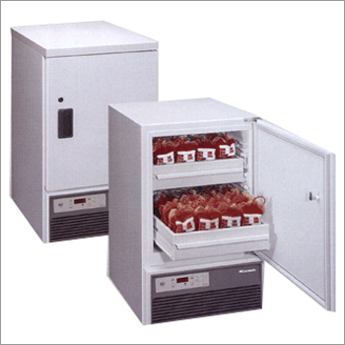
BLOOD BANKING
Notes:
The one big main feature of Blood Banking is ……..SAFETY. In the early days of the malpractice holocaust, typing errors were the biggest source of malpractice suits for pathologists.

Slide 12
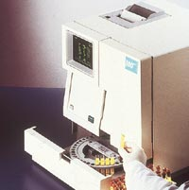
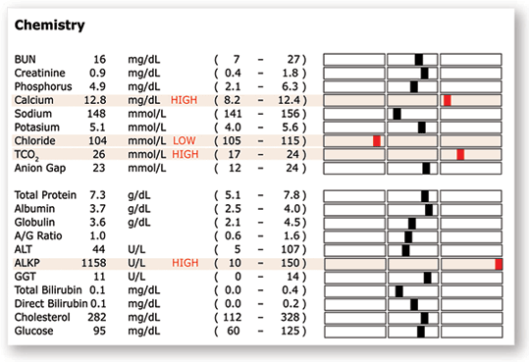
CHEMISTRY
Notes:
A clinical pathologist is supposed to rattle off the differential diagnosis of the red boxes, but the clinical doctors ordering the test for their patient should know better! In many cases the tests are done routinely on all admissions, often being a temptation for not doing a good history and physical.

Slide 13
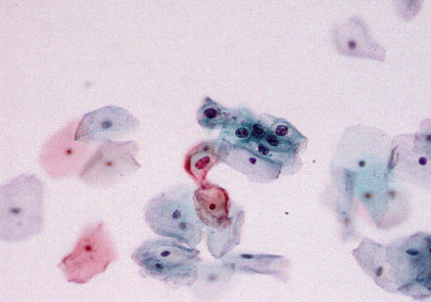
CYTOLOGY
Notes:
The simple visual appearances of nuclei and cytoplasm on exfoliated or aspirated cells is the basis for all cytopathology.

Slide 14
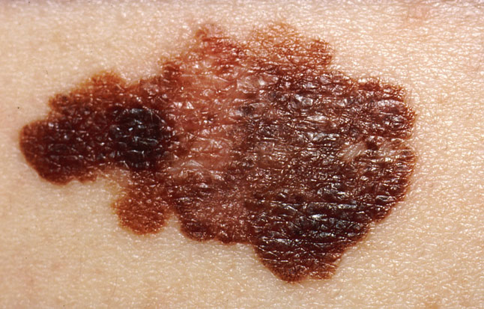
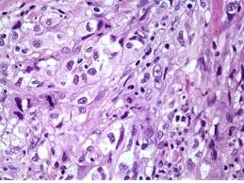
DERMATOPATHOLOGY
Notes:
More and more dermatopathology is being done by dermatologists

Slide 15
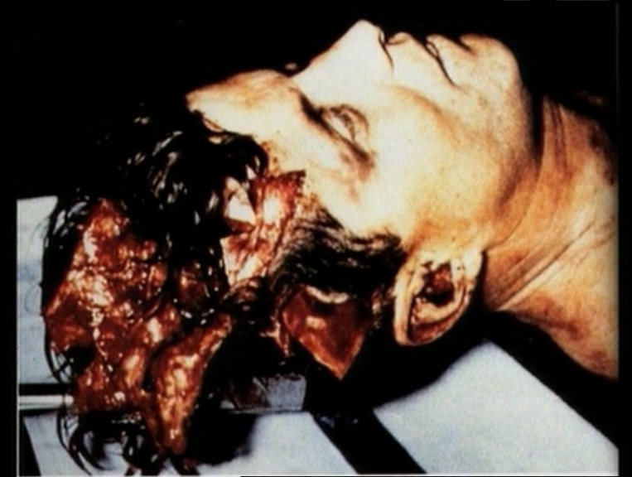
FORENSIC
Notes:
Forensic lectures always make you leave the room in a mild state of shock!

Slide 16
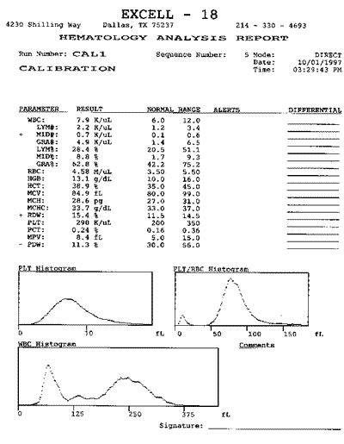
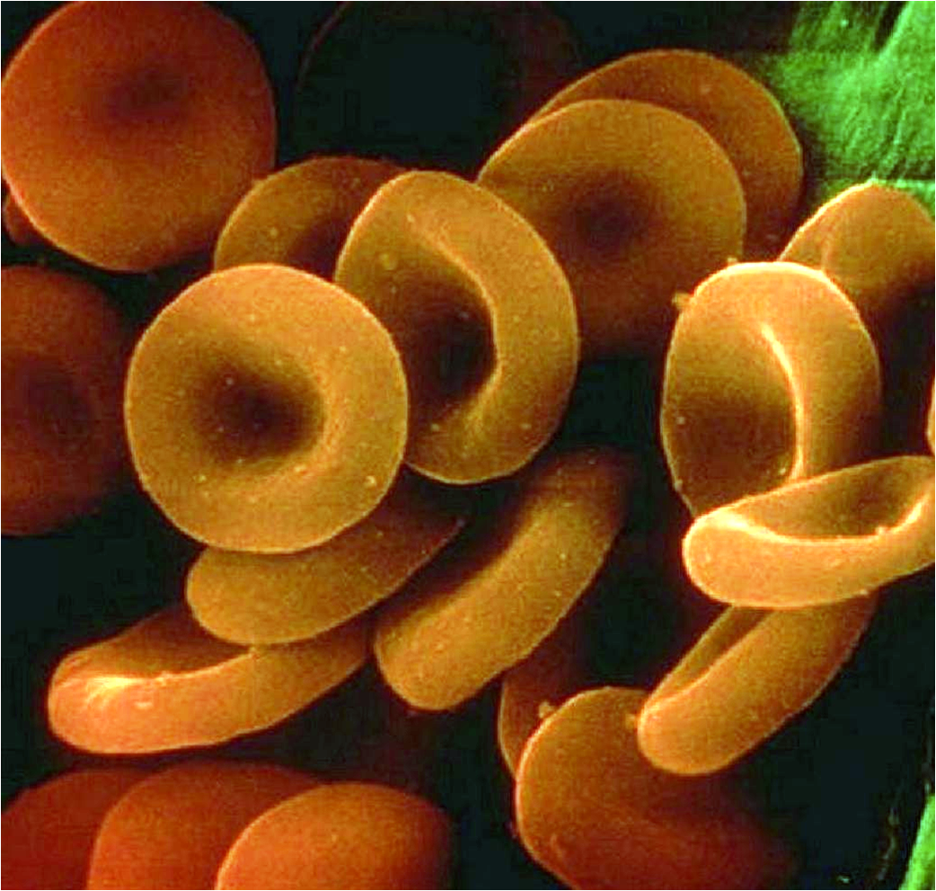
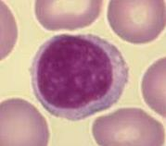
HEMATOPATHOLOGY/HEMATOLOGY
Notes:
Automation rules in hematology, but hematopathology is usually practiced by live people!

Slide 17
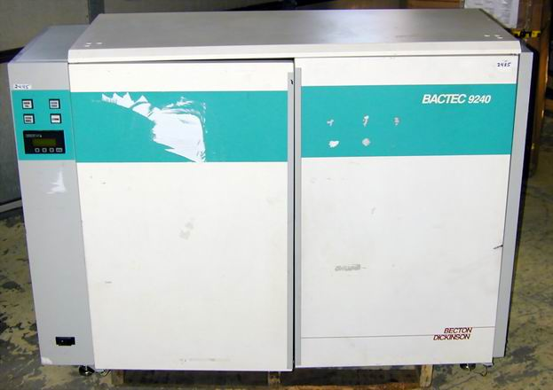
MICROBIOLOGY
Notes:
Automation also rules in microbiology.

Slide 18
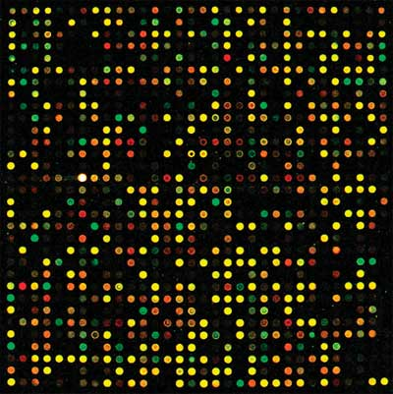
MOLECULAR/GENETIC
Notes:
Molecular pathology skips the slides, skips the antigens, and goes directly to the genes, often mutated, causing diseases.

Slide 19
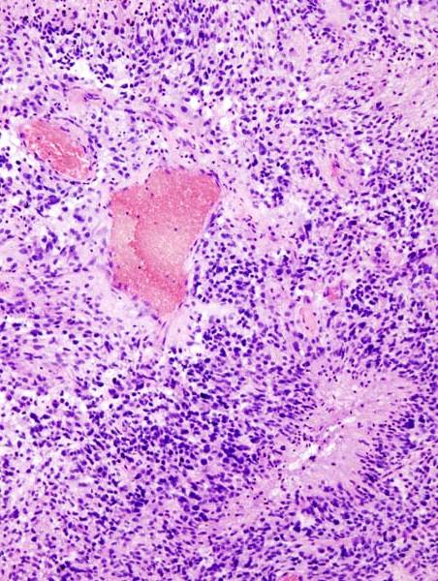
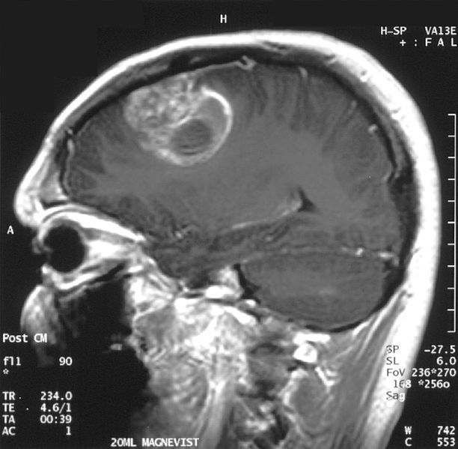
NEUROPATHOLOGY
Notes:
Here is a branch of pathology centered around a body system.

Slide 20

PEDIATRIC
Notes:
Here is a branch of pathology centered around an age group.

Slide 21
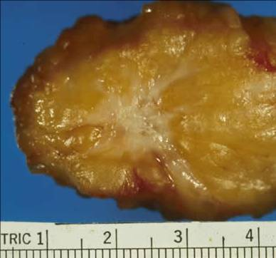
ORGAN SPECIFIC
Notes:
A much controversial and much hated new type of specialty and board exam.

Slide 22
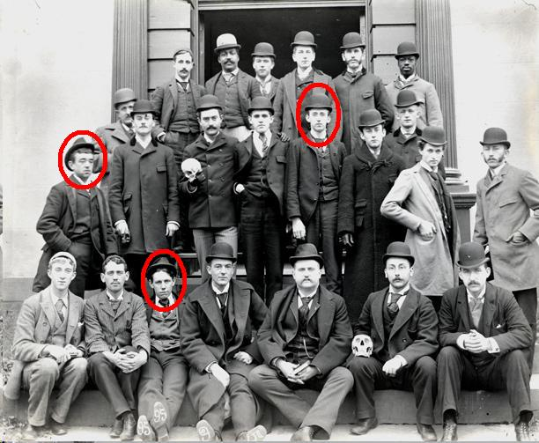
Three Kinds of People Go Into Pathology

Slide 23



1)Geeks 2)Nerds 3)Dorks

Slide 24
INTROVERTS?
Notes:
Not really true but there is a grain of truth in it.

Slide 25
ANSWER:
People who do NOT need or do NOT even enjoy the delusion of constant patient adoration.
Notes:
This is the REAL reason why many students specialize in pathology.

Slide 26
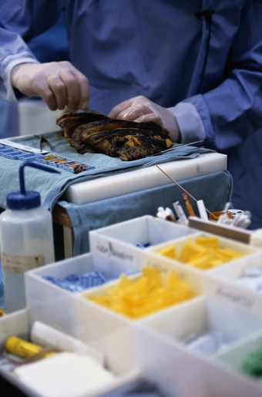
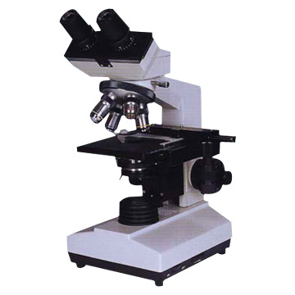
What does a pathologist do?
AM
PM

Slide 27
How does a Pathologist get paid?
Salary
Percentage
Fee for Services (Separate Billing)
Contracts
Salary

Slide 28
Who are pathologists’ FRIENDS?
Other doctors, especially the ones who need reliable reports on tissues which they removed.
Other pathologists, as long as they are not bidding on your contract behind your back.
Reliable lab techs.

Slide 29
Who are pathologists’ ENEMIES?
Other Pathologists
  “Partners”
  Other groups who compete for contracts
Other physicians who want to read their own slides
Malpractice attorneys, who feed on them
Corporate Administrators, who feed on them
“Regulation Agencies”, whose livelihood also depends on feeding on them

Slide 30
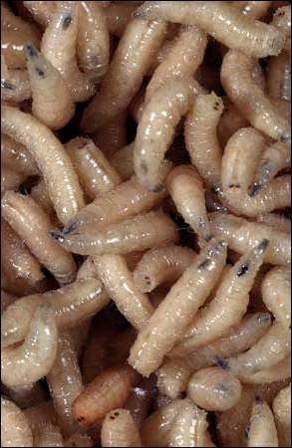

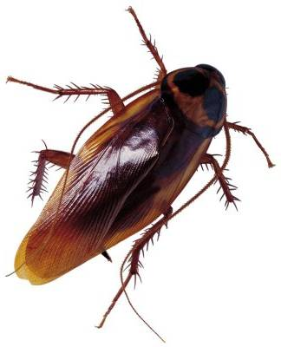
State and Federal License Regulators
Malpractice
Attorneys
Administrators

Slide 31
Reasons to go into pathology
Scientific stimulation
Broad range of skills and knowledge
Connected to all parts of medicine
Good hours, not much demanding call
Ability to work well into 70s+

Slide 32
Reasons NOT to go into pathology
Connected to corporate hospital jackals
Lack of patient contact
Don’t get to play God
Good money, but not lucrative, unless you are a great businessman

